Slide 1

Financial Risk Management
Spring 2016
Dr. Ehud Peleg
Credit Risk II –
Deriving Default Probabilities From Market Prices

Slide 2
Credit Default Swaps
Buyer of the instrument acquires protection from the seller against a default by a particular issuer (the reference entity)
Example: Buyer pays a premium of 90 bps per year for $100 million of 5-year protection against company X
Premium is known as the credit default spread. It is paid for life of contract or until default
If there is a default, the buyer has the right to sell bonds with a face value of $100 million issued by company X for $100 million (Several bonds may be deliverable)

Slide 3
CDS Structure
90 bps per year
Default
Protection
Buyer, A
Default
Protection
Seller, B
Payoff if there is a default by reference entity=100(1-R)
Recovery rate, R, is the ratio of the value of the bond issued by reference entity immediately after default to the face value of the bond

Slide 4
Other Details
Payments are usually made quarterly in arrears
In the event of default there is a final accrual payment by the buyer
Increasingly settlement is in cash and an auction process determines cash amount
Suppose payments are made quarterly in the example just considered. What are the cash flows if there is a default after 3 years and 1 month and recovery rate is 40%?

Slide 5
Attractions of the CDS Market
Allows credit risks to be traded in the same way as market risks
Can be used to transfer credit risks to a third party
More liquidity in taking short position than in bond market

Slide 6
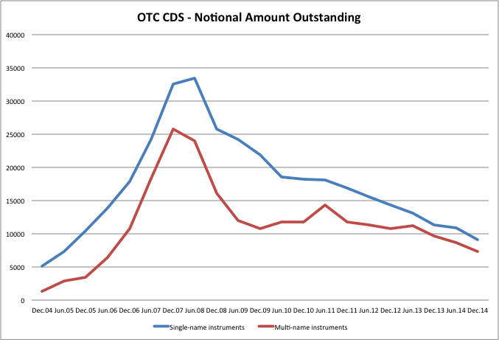
Declining Volumes in OTC CDS
BIS Quarterly Review: June 2015

Slide 7
Setting Credit Spreads
Swaps are typically priced to have a net zero present value at time of initiation.
The credit spread paid by the protection buyer is set so:
PV of expected payments by the protections seller is equal PV of expected payments by the protection buyer.
Expectations are taken in the risk neutral measure and are discounted back with the risk free rate.

Slide 8
Credit Spread and Hazard Rates
One period example:
Suppose the risk-neutral probability of default between time t and t+1, conditional on no-default prior to time t is λ
The protection buyer agrees to pay s in arrears
The protection seller agrees to pay:
$1 for a bond worth R if there is a default
0 if there is no default
The expected payment is (1-λ)*0+ λ (1-R)
s = λ(1-R) or λ = s/(1-R)
For longer periods:

Slide 9
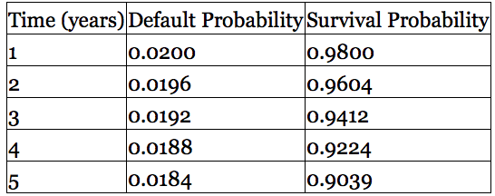
Credit Spread and Hazard Rate (1)
Consider a 5-year CDS, what should be the spread for a given hazard rate? The risk-free rate is 5% and recovery on the bond is 40%
Suppose the hazard rate is 2.0%, first derive the unconditional probabilities of default:
Pr (D=2) = Pr (Survival year 1) * Pr (D=2|Survival year 1)
Pr (Survival year 2) = Pr (Survival year 1)*[1- Pr (D=2|Survival year 1)]

Slide 10
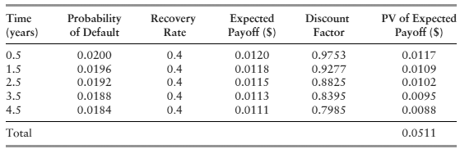
Credit Spread and Hazard Rate (2)
Assumptions regarding payments:
If the reference entity survives a certain year, buyer pays s in arrears
If the reference entity defaults in a certain year, it does so mid-way through the year. At that point: seller pays (1-R), buyer pays s/2
Present Value of protection seller’s payments:

Slide 11
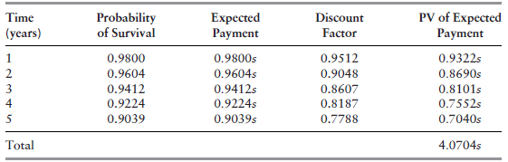
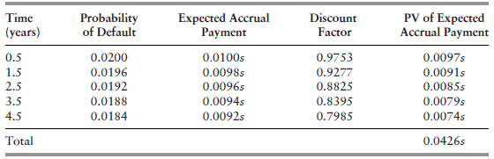
Credit Spread and Hazard Rate (3)
Present Value of protection buyer’s payments:
4.0704s+0.0426s = 4.1130s

Slide 12
Credit Spread and Hazard Rate (4)
4.1130s = 0.0511
s = 0.0124 = 1.24%
Using the approximation:
s = λ(1-R) = 2%*(1-0.4) = 1.20%

Slide 13
Use of Fixed Coupons
Increasingly CDSs and CDS indices trade like bonds
A coupon and a recovery rate is specified
There is an initial payments from the buyer to the seller or vice versa reflecting the difference between the currently quoted spread and the coupon

Slide 14
Credit Indices
CDX.NA.IG: equally weighted portfolio of 125 Investment Grade North American companies
CDX.NA.HY: covers 100 High Yield (Non-Investment Grade) NA borrower
CDX.EM: covers emerging market borrowers
iTraxx: equally weighted portfolio of 125 investment grade European companies
Components of the index are rebalanced twice a year. Each new portfolio is given a series number, e.g. CDX.NA.IG.9

Slide 15
CDX.NA.IG Example
Suppose a trader buys $80,000 protection on each of the 125 companies in the index
A total of $10M notional
The current spread is 203bp
His annual spread payments are:
0.0203*$10M = $203K
If a company defaults, the buyer receives 80,000*(1-R), and the notional is reduced by $80K

Slide 16
London Whale - Background
JP Morgan Synthetic Credit Portfolio is part of its CIO Portfolio
Constructed as hedge to the bank’s long position in credit risk created by its bond and loan portfolio
In 2011 JPM started selling protection on IG to finance buying protection on HY
In Nov 2011, made $400M on American Airlines’ Bankruptcy
It was not hedging any losses in other JP Morgan portfolios.

Slide 17
London Whale - 2012
In order to reduce its Risk Weighted Assets and its exposure to improving credit conditions, the bank increased selling protection on credit indexes (CDX.NA.IG.9 in particular)
By end of March the bank was selling protection on $140B (by some estimates) in IG.9, mostly to hedge funds
In late March, hedge funds stopped buying protection
Eventually JP Morgan had to close out positions by buying protection at increasing prices

Slide 18
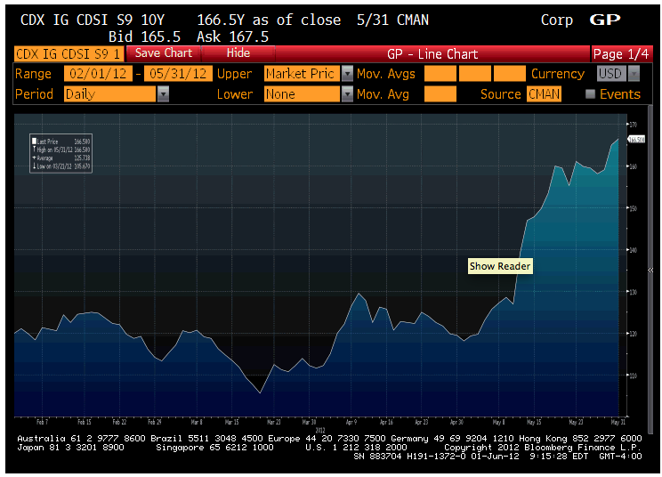
HY Position Losing Money
IG.9 Position making money
Huge losses to close positions
Reached about $140B in sold protection on IG.9

Slide 19
Approximating the loss just in April-May
JPM sold $140B protection at 120bp. What is the MtM of the position if the current spread is 170bp?
Assume defaults occur at end of year.
Derive hazard rate from current spread: Hazard rate = s/(1-R)
Recovery | 40% | LGD | 60%
Current Spread | 1.70% |  | Original Spread | 1.20%
Hazard Rate | 2.83% |  | Notional | 140 | billion
t | PD | Survival | Rates | DF | PV Paying Spread if Survive | PV Paying Spread if Default | PV Spread Payer | PV Protection Seller
1 | 2.83% | 97.17% | 5% | 0.9512 | 1.55 | 0.05 | 1.60 | 2.26
2 | 2.75% | 94.41% | 5% | 0.9048 | 1.44 | 0.04 | 1.48 | 2.09
3 | 2.68% | 91.74% | 5% | 0.8607 | 1.33 | 0.04 | 1.37 | 1.93
4 | 2.60% | 89.14% | 5% | 0.8187 | 1.23 | 0.04 | 1.26 | 1.79
5 | 2.53% | 86.61% | 5% | 0.7788 | 1.13 | 0.03 | 1.17 | 1.65
Total |  |  |  |  |  |  | 6.87 | 9.73
 |  |  |  |  |  |  | Difference: | -2.86

Slide 20
Whale - Report Findings
Actually a failure of Risk Governance
CIO Management gave conflicting and ambiguous goals, did not understand and properly monitor the portfolio position
The Group’s controls and oversight of CIO did not evolve with the increased complexity and risks of the CIO portfolio
CIO Risk function understaffed, and some of the CIO risk personnel lacked the needed skills
Inappropriate MTM to better prices than mid led to Income statement restatements

Slide 21
Whale - Limit Breaches
The unit operated with three types of limits
VaR limit was breached multiple times in January leading to breach in the JP Morgan’s overall VaR
Breaches were “fixed” by changing the VaR model
Non-statistical: CSBPV and CSW 10%
Measure the effect of spreads widening; Does not take into consideration correlations
Indications that portfolio was turning long on selling protection were ignored
Breached in March, but was downplayed as irrelevant measure
Stress test limits were also breached but too late

Slide 22
Whale - VaR Model
The new CIO VaR model was not tested properly, and understated the risks in Q1 2012
VaR model changed from “linear sensitivities” to “full revaluation”,
from only considering spread changes, to considering portfolio correlations
Limited back-testing by model validators due to “lack of historical data”
Operational issues due to use of manual excel sheets
E.g. Excel mistake: divided by sum instead of average
Made assumption regarding vendor method of calculation, which was wrong

Slide 23
Credit Default Swaps and Bond Yields
Portfolio A:
5-year par corporate bond that provides a yield of 6%
Buy protection using a 5-year CDS costing 100 bps per year
Portfolio B:
long position in a riskless instrument paying 5% per year
What are arbitrage opportunities if risk-free rate is not 5%, but 4.5%? What if it is 5.5%?
Buy bond to get 6% coupon and buy protection for 1%, Short risk free bond to pay 4.5% per year

Slide 24
Risk-free Rate
The risk-free rate used by bond traders when quoting credit spreads is the Treasury rate
The risk-free rate traditionally assumed in derivatives markets is the LIBOR/swap rate
By comparing CDS spreads and bond yields it appears that in normal market conditions traders are assuming a risk-free rate 10 bp less than the LIBOR/swap rates
In stressed market conditions the gap between the LIBOR/swap rate and the “true” risk-free rate is liable to be much higher

Slide 25
CDS-Bond Basis
This is the CDS spread minus the Bond Yield Spread
Bond yield spread to LIBOR is usually calculated as the asset swap spread
Asset Swaps allow to convert the bond fixed rate payments to floating (LIBOR) payment
Tended to be positive pre-crisis
In general, any feature that would make the insurance guaranteed by CDS more valuable will make the spread increase

Slide 26
Factors Affecting CDS-Bond Basis
The bond may sell for a price different than par (prices above par decrease basis; below par increase basis)
Counterparty default risk in a CDS (push basis in negative direction)
Cheapest-to-deliver bond option in CDS (pushes basis in positive direction)
Payoff on a CDS does not include accrued interest on the bond delivered (push basis in negative direction)
Restructuring clause in CDS contract may lead to payoff when there is no default (push basis in positive direction)

Slide 27
Deriving PD from Bond Prices
Consider a defaultable bond paying 100 in 1-year. The yield on the bond is 8%. A riskless bond with similar promised payment has a yield of 6%.
The price of the riskless bond is 100/1.06=94.34
The price of the risky bond is 100/1.08=92.59
The difference between them, 1.75, is the present value of expected loss from default

Slide 28
Deriving PD from Bond Prices (2)
We have two ways of pricing the defaultable bond
Discount the promised cashflows with the risky yield - 100/1.08=92.59
Discount the expected cashflows under the risk neutral measure with the risk free rate
Suppose the risk-neutral probability of default is Q
The expected cashflows are 100*(1-Q)+100*R*Q = 100[1-Q*(1-R)]
Assume R=0.4, the two methods will give the same result if: 100[1-Q*(1-R)]/1.06=100/1.08
Q=[1-1.06/1.08]/(1-0.4) = 3.09%
The present value of expected loss from default is:
100*PD*(1-R)/(1+rf) = 100*3.09%*(1-0.4)/1.06 = 1.75

Slide 29
Applying the method for longer term bonds
Suppose that a five year corporate bond pays a coupon of 6% per annum (semiannually). The yield is 7% with continuous compounding and the yield on a similar risk-free bond is 5% (with continuous compounding)
The expected loss from defaults is 8.75. This can be calculated as the difference between the market price of the bond and its risk-free price (104.09 – 95.34)
Suppose that the unconditional probability of default is Q per year and that defaults always happen half way through a year (immediately before a coupon payment).

Slide 30
Calculations
Time (yrs) | Def Prob | Recovery Amount | Risk-free Value | Loss | Discount Factor | PV of Exp Loss
0.5 | Q | 40 | 106.73 | 66.73 | 0.9753 | 65.08Q
1.5 | Q | 40 | 105.97 | 65.97 | 0.9277 | 61.20Q
2.5 | Q | 40 | 105.17 | 65.17 | 0.8825 | 57.52Q
3.5 | Q | 40 | 104.34 | 64.34 | 0.8395 | 54.01Q
4.5 | Q | 40 | 103.46 | 63.46 | 0.7985 | 50.67Q
Total |  |  |  |  |  | 288.48Q

Slide 31
Calculations continued
Note:
To get Risk Free Value, we need forward rates. In this case, all are assumed to be 5%
CDS Pays back Notional Value and recovery is assumed 40% of Par Value
We set 288.48Q = 8.75 to get Q = 3.03%
This analysis can be extended to allow defaults to take place more frequently
With several bonds we can use more parameters to describe the default probability distribution (rather than Q for all maturities)

Slide 32
Structural Models of Default
Structural models attempt to explain the mechanism by which default occurs.
Merton (1974) is the prototype model
The firm’s assets follow a stochastic process (V_{t})
The firm has one zero coupon bond issued with face value D, maturing at time T
At any time the value of the firm is given by:
V_{t}=E_{t}+D_{t}

Slide 33
Value of Debt and Equity at Bond Maturity, T
V_{T} > D: the assets are worth more than the debt. The debt holders receive D. The shareholders receive E_{T} = V_{T} – D
V_{T} ≤ D: the assets are worth less than the debt. The firm cannot pay its obligations.
The equity is worth 0.
Shareholders have limited liability.
The firm is liquidated and the bond holders receive D_{T} = V_{T}.

Slide 34
Equity and Debt as Contingent Claims
The model regards the equity as a European call option on the assets of the firm with the strike price equal to the debt’s notional value:
E_{T} = max(V_{T} – D, 0)
The bond equals the notional value of the bond minus a European put option with strike price equal to the debt value:
D_{T} = D – max(D – V_{T}, 0)

Slide 35
Underlying Process for Assets
The assets of the firm follow a Geometric Brownian Motion in the real-world probability measure:
Apply Ito’s lemma and integrate from 0 to T:
The probability of default is:

Slide 36
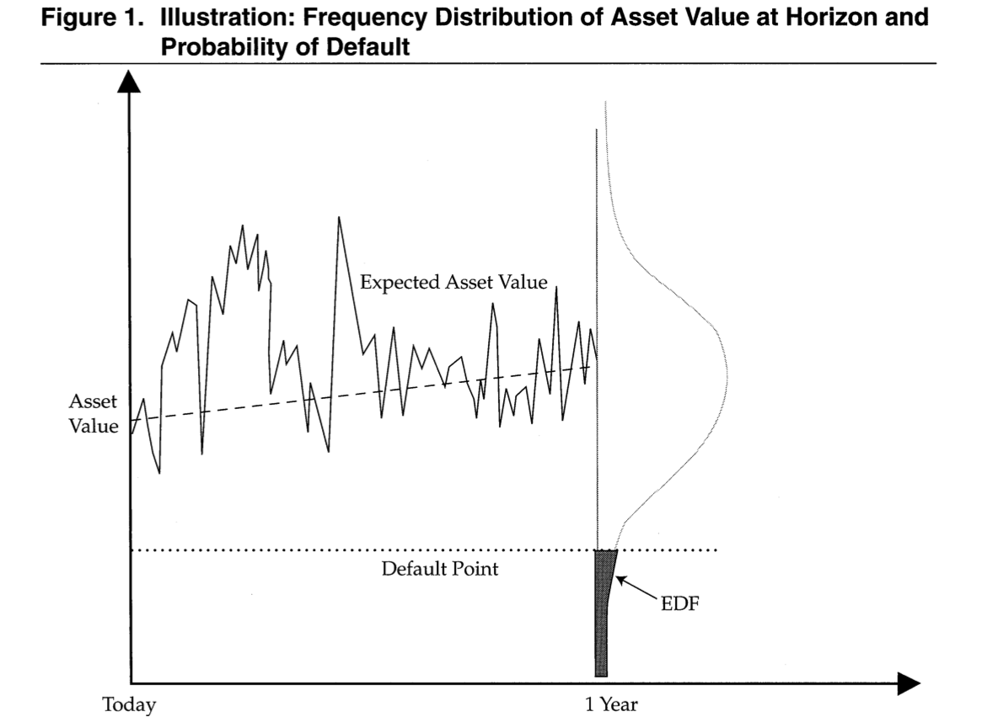
V₀ = ? , μ_{V} = ? , σ_{V} = ?
Kealhofer – FAJ (2003)

Slide 37
Risk Neutral Probability of Default
The risk neutral probability of default is:
RN probability of default is:
Decreasing with V₀
Increasing with D
Increasing in σ_{V} if V₀ > D

Slide 38
Risk Neutral World
In order to find the probability of default, we have to find V₀ and σ_{V}.
We use Black-Scholes to find the value of the firm’s equity today , E₀, as a function of the value of its assets today, V₀, and the volatility of its assets, σ_{V}

Slide 39
Applying the model
Since E is a contingent claim on V, we can use Ito’s lemma to get:
This equation together with the option pricing relationship enables V₀ and σ_{V} to be determined from E₀ and σ_{E}

Slide 40
Example
A company’s equity is $3 million and the volatility of the equity is 80%
The risk-free rate is 5%, the debt is $10 million and time to debt maturity is 1 year
Solving the two equations yields V₀=12.40 and σ_{v}=21.23%

Slide 41
Example continued
The Risk Neutral probability of default is N(-d₂) or 12.7%
The market value of the debt is V₀-E₀=9.40
The risk-free present value of the debt is 9.51
PV of expected losses = 0.11
The expected loss at T=1 is 0.11*exp(0.05)/10= 1.2%
(1-Recovery)*12.7% = EL = 1.2%
The recovery rate is 91%

Slide 42
Distance to Default
N(-d₂) is the probability of default.
KMV define Distance to Default as the number of standard deviations the firm value is from the default level
It is a measure of how unlikely is default
It is an approximation of d₂ (T=1)

Slide 43
The Implementation of Merton’s Model to estimate real-world default probability (e.g. Moody’s KMV)
Calculate cumulative obligations to time horizon. We denote it by D
Use Merton’s model to calculate a theoretical probability of default, or Distance to Default
Use historical data to develop a one-to-one mapping of theoretical probability into real-world probability of default.
Assumption is that the rank ordering of probability of default given by the model is the same as that for real world probability of default

Slide 44
Real World vs Risk-Neutral Default Probabilities
The default probabilities backed out of bond prices or credit default swap spreads are risk-neutral default probabilities
The default probabilities backed out of historical data are real-world default probabilities

Slide 45
A Comparison
Calculate 7-year hazard rates from the Moody’s data (1970-2010). These are real world default probabilities)
Use Merrill Lynch data (1996-2007) to estimate average 7-year default intensities from bond prices (these are risk-neutral default intensities)
Assume a risk-free rate equal to the 7-year swap rate minus 10 basis points

Slide 46
Real World vs Risk Neutral Default Probabilities (7 year averages)

Slide 47
Risk Premiums Earned By Bond Traders

Slide 48
Possible Reasons for These Results
Corporate bonds are relatively illiquid
Bonds do not default independently of each other. This leads to systematic risk that cannot be diversified away.
Bond returns are highly skewed with limited upside. The non-systematic risk is difficult to diversify away and may be priced by the market
The subjective default probabilities of bond traders may be much higher than the estimates from Moody’s historical data

Slide 49
Which World Should We Use?
We should use risk-neutral estimates for valuing credit derivatives and estimating the present value of the cost of default
We should use real world estimates for calculating credit VaR and scenario analysis

Slide 50
Thanks

